Slide 1
YELP DATA challenge
Shiqing Chen, Jahnavi Nadipi, Wenliang Sun, Jiaru Zhu

Slide 2
Finalized Idea
LOCATION
CUISINE
KEYWORDS
98
Finalized
IDEA
Predict Success
of new restaurants

Slide 3
Finalized Idea
FOOD
University
College Town
Score
Keywords

Slide 4





DATA Acquisition

Slide 5
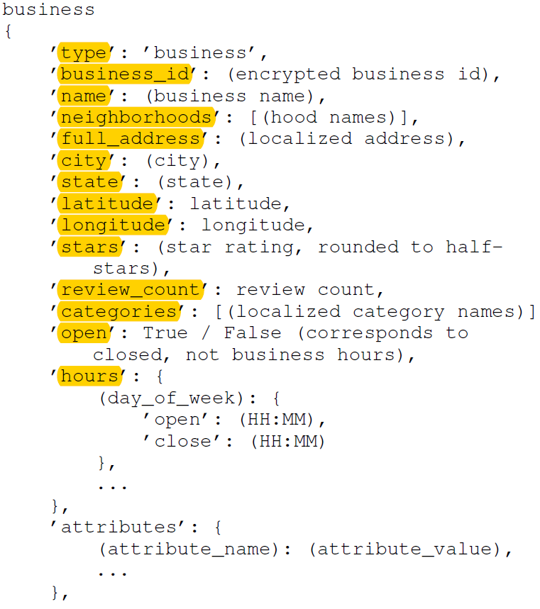

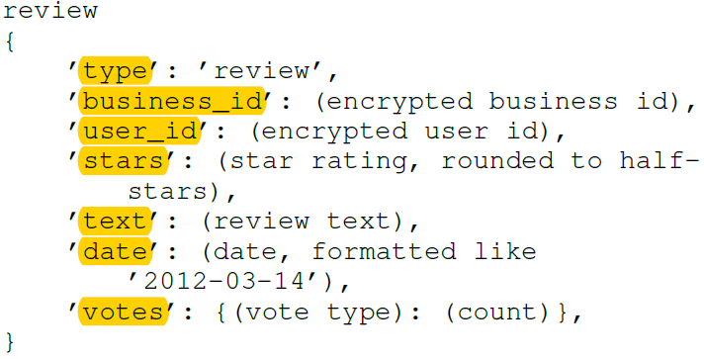
Dataset Attributes

Slide 6
Dataset Attributes
collegetowns
{
‘town_id’: (college town id),
’name’: (town name),
’state’: (state),
’population’: (population of town),
’latitude’: latitude,
’longitude’: longitude,
‘politics’: (polictics),
‘demographics’: (demographics),
‘median_income’: median income,
‘university_name’: (name of the university),
‘university_type’: (private or public),
‘student_population’: number of students,
‘university_demographics: (demographics of the university),
‘university_type’: (private or public),
‘university_tuition’: tuition of international students,
…
},
’attributes’: {
(attribute_name): (attribute_value),
...
},
}
COLLEGE
TOWN

Slide 7
FEATURE EXTRACTION
Location
Review count
Price range
Stars
Accepts credit cards
Has take-out
Has delivery
Cuisine
Free Wifi
Keywords
Sentiments
Town Population
University Population
Town income
Town demographics
University demographics
University tuition
University type
International students population

Slide 8
Data Preprocessing
Review Texts
Text Cleaning
Vocabulary Extraction
Vocabulary Cleaning
Extract Sentiment Features
REVIEW
TEXTS

Slide 9
Data Preprocessing
Location Clustering

Slide 10
WORKFLOW
Complete a Survey of FEATURES
Find the TOWN A that’s most similar
Give a final score for such resturant
Determine the restaurant that’s most similar in TOWN A
Extract location and determine the location clustering
Extract keywords and determine sentiment analysis
Combine the results in the above three in weighted approach
Extract TOWN and UNIVERSITY from the Survey

Slide 11
ML ALGORITHM
Rule-based Classifier:
(1)Classify records by using a collection of “if...then...” rules.
(2)Rule: (Condition) -> (Rule consequent)
(3) Advantages:
As highly expressive as decision trees
Easy to interpret
Easy to generate
Can classify new instances rapidly
Performance comparable to decision trees
(4) Examples:
(Free Wifi = YES) ^ (Cuisine =Chinese) -> Popular
(Has delivery = YES) ^ (Stars >= 4) ^(Price range < $20)-> Popular
…

Slide 12
Dicrect Method Progress
Grow a single rule
Remove Instances from rule
Prune the rule
Add rule to Current Rule Set &Repeat

Slide 13
ML ALGORITHM
KNN Algorithm
The output is a class membership. An object is classified by a majority vote of its neighbors, with the object being assigned to the class most common among its k nearest neighbors
Step:
Compute distance to other data
Identity K NNs
Use class labels Nearest Neighbors to determine the class label of unknown data

Slide 14




ENVIRONMENT SETUP

Slide 15
PERFORMANCE
Validation Accuracy
Training Accuracy
MSE

Slide 16
TEST CASE： Little Szechuan
Location: 228 W College Avenue, State College , PA 16801
Review count: 119
Price range: $$$$
Stars: 4 stars
Accepts credit cards: YES
Has take-out: YES
Has delivery: YES
Cuisine: Chinese
Free Wifi: NO
Keywords: Szechuan, Seafood, Hot Pot
Noise Level: Average

Slide 17
Limitations
Underfit
Survey
Town

Slide 18
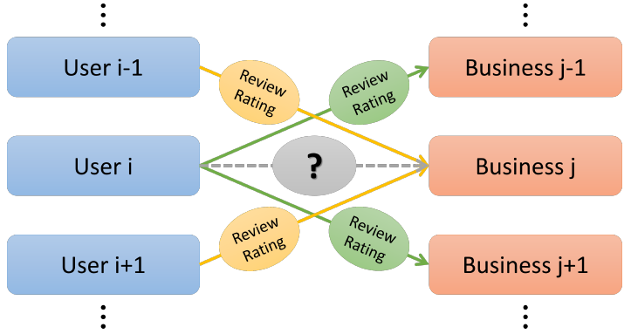
RELATED WORKS
Prediction of Yelp Review Star Rating using Sentiment Analysis
Chen Li (Stanford EE) & Jin Zhang (Stanford CEE)
Notes:
Apply machine learning to predict a customer's star rating of a restaurant based on his/her reviews, as well as other customers' reviews/ratings, to recommend other restaurants to the customer

Slide 19
RELATED WORKS
Predicting International Restaurant Success with Yelp
Angela Kong, Vivian Nguyen, and Catherina Xu
Notes:
The ability to identify business features that are most
indicative of success on Yelp can help restaurants devise
sensible strategies to improve their own ratings. Specifically,
we will explore how features gain and lose importance as
we vary geographical location by country.

Slide 20
Thank you! Questions?
Shiqing Chen, Jahnavi Nadipi, Wenliang Sun, Jiaru Zhu

